Slide 1
StServer Test application
Purpose:
To generate reports for sample eFile deals using the new STServer version sent by Ivory (third party vendor), and compare these reports with the reports generated using the current StServer version. This comparison is done to verify if the enhancements/bug fixes done by Ivory doesn’t adversely affect our eFile application.
Source Code:
VSS $Siebel/Efile/BSCEFSuperTrump/StServerTestProjects/STServerTest/ folder

Slide 2
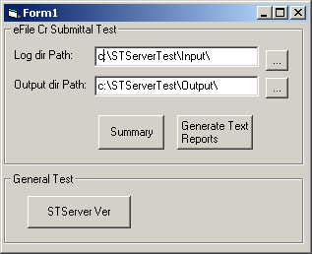
StServer Test application
Step2: Enter/Select path of the sample Efile deals (Input folder)
Step 1: Check version of the New StServer DLL to ensure you are testing the correct version
Step3: Enter/Select path where the reports would be stored (Output folder)
Step 4: Click to generate the reports

Slide 3
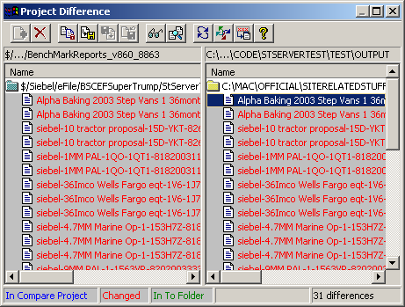
StServer Test application
Step 5: Compare the report files in the “Output” folder with the report files in the “BenchMarkReports_v860_8863” folder. You can use VSS or any other file comparison tool. Report any discrepancies to the appropriate individuals.

Slide 4
ST Web Service Test application
Purpose:
To test the core methods of the SuperTrump Web Service component (BSCEFSuperTrump). This will ensure that live sites, invoking this component, would work fine with this new StServer version.
Source Code:
VSS $Siebel/Efile/BSCEFSuperTrump/StServerTestProjects/STWebSvcTest/ folder

Slide 5
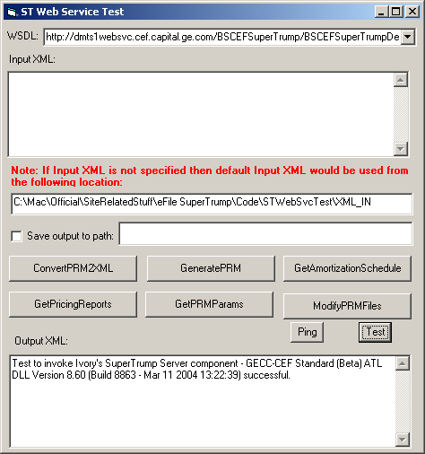
ST Web Service Test application
Step 1: Select the appropriate SuperTrump web service wsdl which uses the new StServer component.
Step 2: Check version of the New StServer DLL to ensure you are testing the correct version

Slide 6
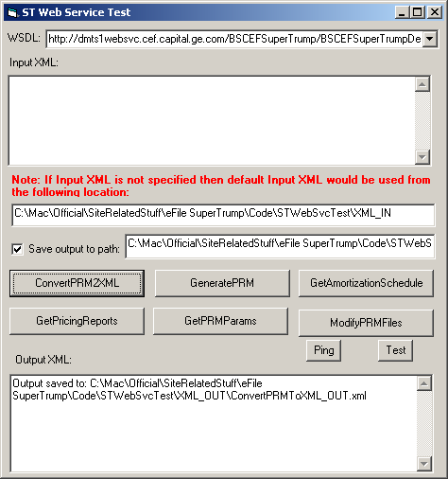
ST Web Service Test application
Step 3: Check this to save output XML to the specified folder (default “XML_OUT” folder)
Step 4: Click on each of these six buttons to generate the appropriate output XML files.

Slide 7
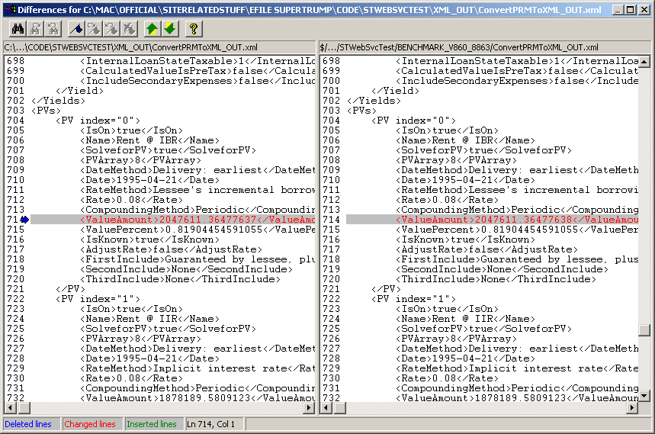
ST Web Service Test application
Step 5: Compare the output XML files in the “XML_OUT” folder with the XML files in the “BENCHMARK_V860_8863” folder. You can use VSS or any other file comparison tool. Report any discrepancies to the appropriate individuals.

